Slide 1

How to know what measurement level your variable is
Week 3 HRA2

Slide 2
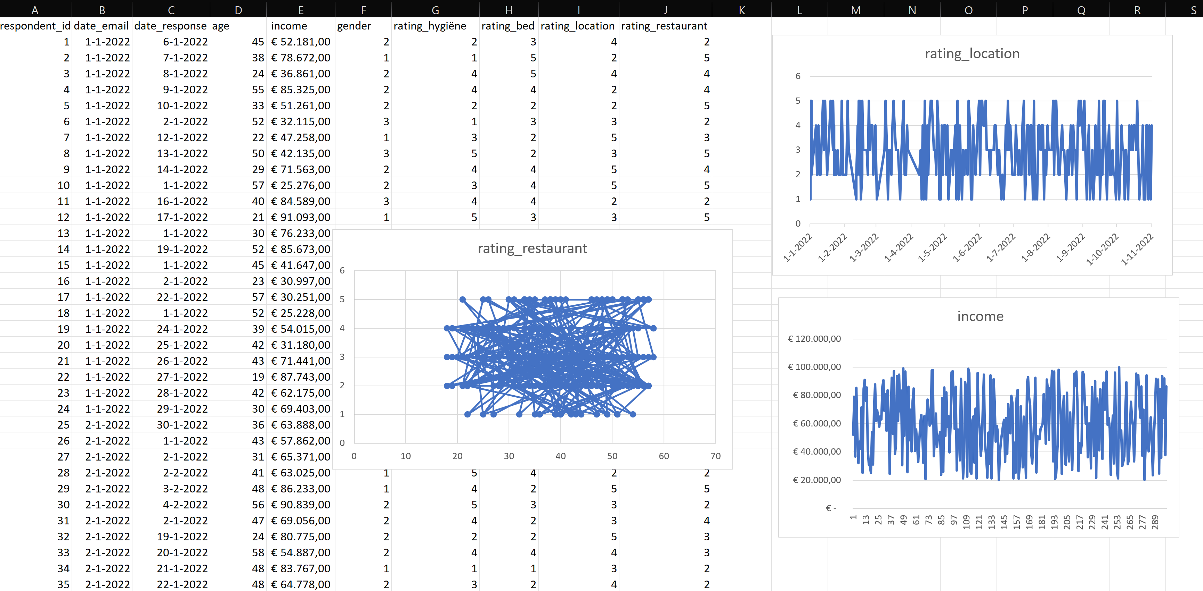
Don’t do this!

Slide 3
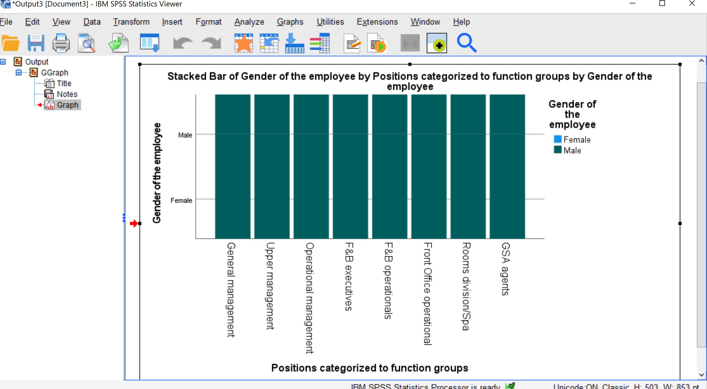
Or this!

Slide 4
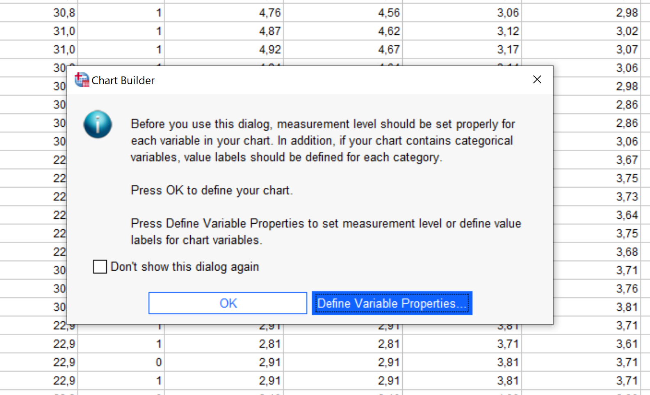
This is what SPSS tells you to do as well

Slide 5




What measurement level?
Nominal
Categories are equal ( = and ≠)
Categorical
Labels; bins; distinct categories; making groups
Abc
Ordinal
There is an order to the categories ( > and < )
Variable
Interval
Categories have the same distance ( + and -)
123
Continuous
Figures; continuous spectrum on which to place cases
Ratio
There is an absolute 0-point (* and /)
*See also Verhoeven N. (2019), Doing research, pp. 244 – 250.

Slide 6
What measurement level?
Nominal
Categories are equal ( = and ≠)
Categorical
Labels; bins; distinct categories; making groups
Abc
Ordinal
There is an order to the categories ( > and < )
Variable
Interval
Categories have the same distance ( + and -)
123
Continuous
Figures; continuous spectrum on which to place cases
Ratio
There is an absolute 0-point (* and /)
*See also Verhoeven N. (2019), Doing research, pp. 244 – 250.

Slide 7
What measurement level?
Nominal
Categories are equal ( = and ≠)
Categorical
Labels; bins; distinct categories; making groups
Abc
Ordinal
There is an order to the categories ( > and < )
Variable
Interval
Categories have the same distance ( + and -)
123
Continuous
Figures; continuous spectrum on which to place cases
Ratio
There is an absolute 0-point (* and /)
*See also Verhoeven N. (2019), Doing research, pp. 244 – 250.

Slide 8
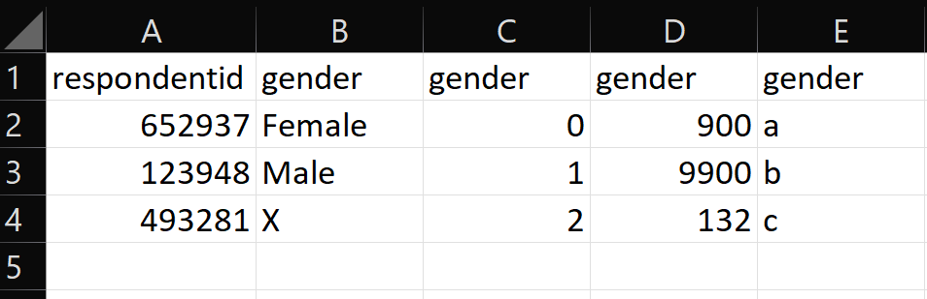
What measurement level?
Nominal
Categories are equal ( = and ≠)
Categorical
Labels; bins; distinct categories; making groups
Abc
Ordinal
There is an order to the categories ( > and < )
Variable
Interval
Categories have the same distance ( + and -)
123
Continuous
Figures; continuous spectrum on which to place cases
Ratio
There is an absolute 0-point (* and /)
*See also Verhoeven N. (2019), Doing research, pp. 244 – 250.

Slide 9
What measurement level?
Nominal
Categories are equal ( = and ≠)
Categorical
Labels; bins; distinct categories; making groups
Abc
Ordinal
There is an order to the categories ( > and < )
Variable
Interval
Categories have the same distance ( + and -)
123
Continuous
Figures; continuous spectrum on which to place cases
Ratio
There is an absolute 0-point (* and /)
*See also Verhoeven N. (2019), Doing research, pp. 244 – 250.

Slide 10
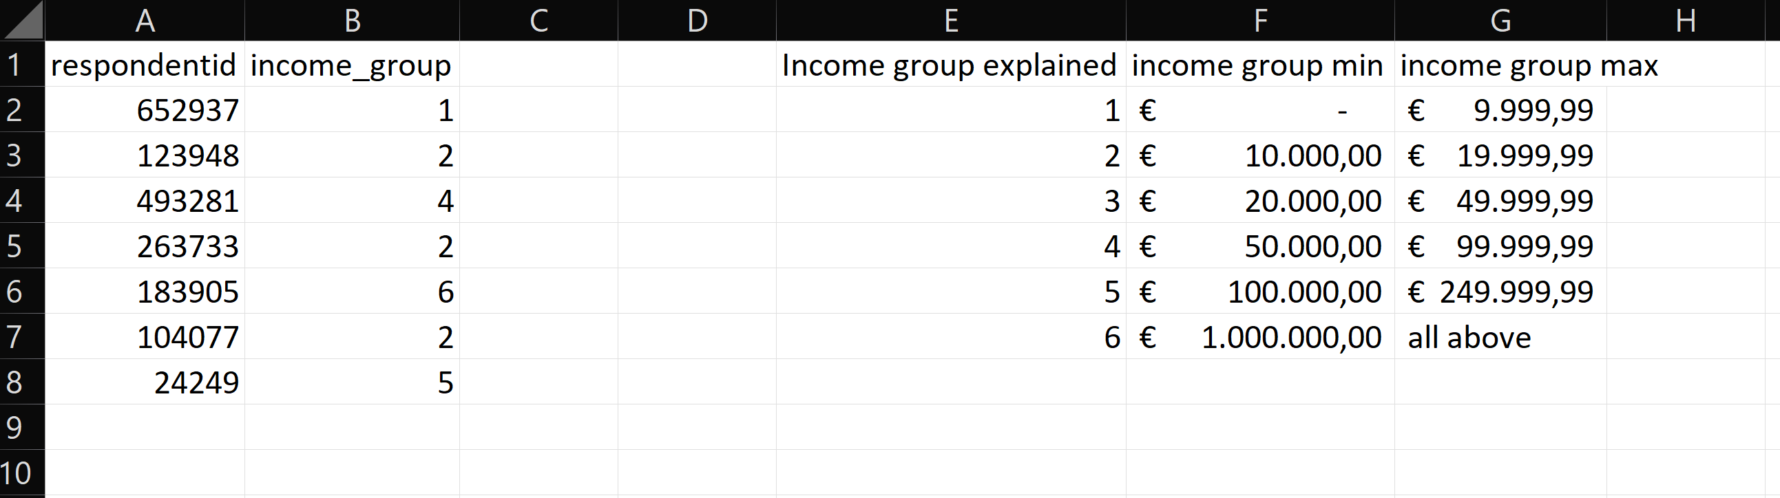
What measurement level?
Nominal
Categories are equal ( = and ≠)
Categorical
Labels; bins; distinct categories; making groups
Abc
Ordinal
There is an order to the categories ( > and < )
Variable
Interval
Categories have the same distance ( + and -)
123
Continuous
Figures; continuous spectrum on which to place cases
Ratio
There is an absolute 0-point (* and /)
*See also Verhoeven N. (2019), Doing research, pp. 244 – 250.

Slide 11
What measurement level?
Nominal
Categories are equal ( = and ≠)
Categorical
Labels; bins; distinct categories; making groups
Abc
Ordinal
There is an order to the categories ( > and < )
Variable
Interval
Categories have the same distance ( + and -)
123
Continuous
Figures; continuous spectrum on which to place cases
Ratio
There is an absolute 0-point (* and /)
*See also Verhoeven N. (2019), Doing research, pp. 244 – 250.

Slide 12
What measurement level?
Nominal
Categories are equal ( = and ≠)
Categorical
Labels; bins; distinct categories; making groups
Abc
Ordinal
There is an order to the categories ( > and < )
Variable
Interval
Categories have the same distance ( + and -)
123
Continuous
Figures; continuous spectrum on which to place cases
Ratio
There is an absolute 0-point (* and /)
*See also Verhoeven N. (2019), Doing research, pp. 244 – 250.

Slide 13
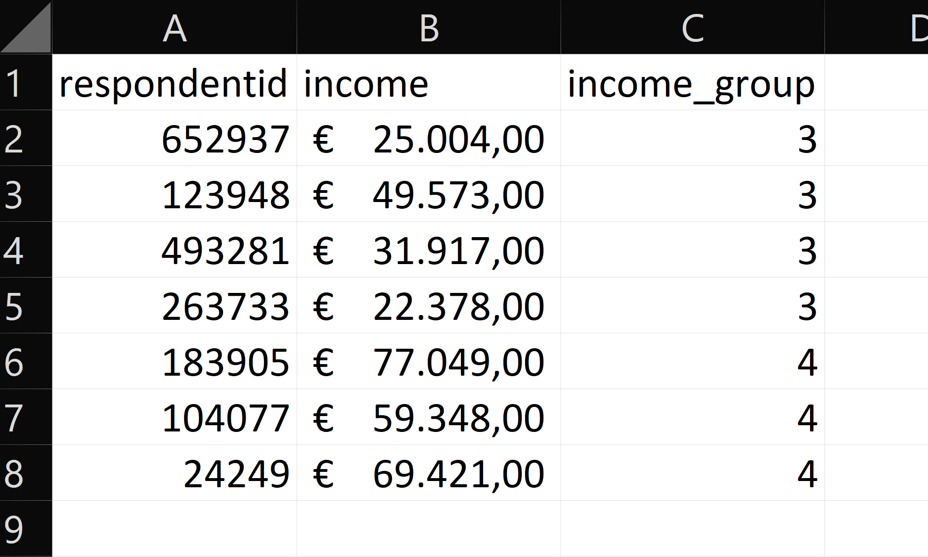
What measurement level?
Nominal
Categories are equal ( = and ≠)
Categorical
Labels; bins; distinct categories; making groups
Abc
Ordinal
There is an order to the categories ( > and < )
Variable
Interval
Categories have the same distance ( + and -)
123
Continuous
Figures; continuous spectrum on which to place cases
Ratio
There is an absolute 0-point (* and /)
*See also Verhoeven N. (2019), Doing research, pp. 244 – 250.

Slide 14
What measurement level?
Nominal
Categories are equal ( = and ≠)
Categorical
Labels; bins; distinct categories; making groups
Abc
Ordinal
There is an order to the categories ( > and < )
Variable
Interval
Categories have the same distance ( + and -)
123
Continuous
Figures; continuous spectrum on which to place cases
Ratio
There is an absolute 0-point (* and /)
*See also Verhoeven N. (2019), Doing research, pp. 244 – 250.

